Slide 1

Natural Language Processing
Rohit Kate
Recurrent Neural Networks – Part 2

Slide 2
Long Distance Dependencies
It is very difficult to train RNNs to retain information over many time steps
Simple RNNs tend to “forget” what was seen over a long range
Backpropagating error through all hidden layers unrolled over time diminishes it

Slide 3
Long Distance Dependencies
For example, handle long-distance dependencies, such as subject-verb agreement, common in natural languages
Suppose the task is to classify whether the sentence is grammatical or not
The speaker spoke against the politician who supports the bill.
The speaker spoke against the politicians who support the bill.
The speaker spoke against the politicians and supports the bill.
The speakers spoke against the politicians and support the bill.

Slide 4
How to make RNNs remember over long distances?
The hidden state is updated after seeing every word and hence is prone to forget things over long distances
We need something more that can store relevant information and does not get updated on seeing every word
It should update when something important is seen that is relevant for the task, forgetting the previous value
It should be learnable based on the task:
When to forget the previous value
When to add the new value

Slide 5
LSTM
Long short-term memory (LSTM) is a special cell used as a hidden layer in RNNs
RNNs that use LSTM cells are also called LSTM networks
Besides the usual hidden layer state, it has an extra state – cell state
Hidden state
Stores representation so far
Is updated with every word
Short-term memory
Cell state
Stores only the relevant information
Is updated only when needed
Long-term memory
Enables long distance dependencies

Slide 6
Illustrative Example
The following is an illustrative example, an actual LSTM’s states may not be so explicit; h and c stand for representations
Cell state:
Hidden state:
The speaker spoke against the politicians and supports the bill.

Slide 7
Illustrative Example
Cell state:
_
Hidden state:
h(the)
The speaker spoke against the politicians and supports the bill.

Slide 8
Illustrative Example
Cell state:
c(speaker)
Add
Hidden state:
h(the,speaker)
h(the)
The speaker spoke against the politicians and supports the bill.

Slide 9
Illustrative Example
Cell state:
c(speaker)
Hidden state:
h(the, speaker)
h(the,speaker,spoke)
The speaker spoke against the politicians and supports the bill.

Slide 10
Illustrative Example
Cell state:
c(speaker)
Hidden state:
h(the,speaker,spoke)
h(the,speaker,spoke,against)
The speaker spoke against the politicians and supports the bill.

Slide 11
Illustrative Example
Cell state:
c(speaker)
Hidden state:
h(the,speaker,spoke,against)
h(the,speaker,spoke,against,the)
The speaker spoke against the politicians and supports the bill.

Slide 12
Illustrative Example
Cell state:
c(speaker)
Hidden state:
h(the,speaker,spoke,against,the)
h(the,speaker,spoke,against,the,politicians)
The speaker spoke against the politicians and supports the bill.

Slide 13
Illustrative Example
Cell state:
c(speaker)
Hidden state:
h(the,speaker,spoke,against,the,politicians)
h(the,speaker,spoke,against,the,politicians,and)
The speaker spoke against the politicians and supports the bill.

Slide 14
Illustrative Example
Ungrammaticality could have been caught here
Cell state:
c(speaker)
Hidden state:
h(the,speaker,spoke,against,the,politicians,and)
h(the,speaker,spoke,against,the,politicians,and,supports)
The speaker spoke against the politicians and supports the bill.

Slide 15
Illustrative Example
Cell state:
c(speaker)
Hidden state:
h(the,speaker,spoke,against,the,politicians,and,supports)
h(the,speaker,spoke,against,the,politicians,and,supports,the)
The speaker spoke against the politicians and supports the bill.

Slide 16
Illustrative Example
Cell state:
c(speaker)
Hidden state:
h(the,speaker,spoke,against,the,politicians,and,supports,the)
h(the,speaker,spoke,against,the,politicians,and,supports,the,bill)
The speaker spoke against the politicians and supports the bill.

Slide 17
Illustrative Example
Now a different sentence
Cell state:
Hidden state:
The speaker spoke against the politicians who support the bill.

Slide 18
Illustrative Example
Cell state:
_
Hidden state:
h(the)
The speaker spoke against the politicians who support the bill.

Slide 19
Illustrative Example
Cell state:
c(speaker)
Add
Hidden state:
h(the,speaker)
h(the)
The speaker spoke against the politicians who support the bill.

Slide 20
Illustrative Example
Cell state:
c(speaker)
Hidden state:
h(the, speaker)
h(the,speaker,spoke)
The speaker spoke against the politicians who support the bill.

Slide 21
Illustrative Example
Cell state:
c(speaker)
Hidden state:
h(the,speaker,spoke)
h(the,speaker,spoke,against)
The speaker spoke against the politicians who support the bill.

Slide 22
Illustrative Example
Cell state:
c(speaker)
Hidden state:
h(the,speaker,spoke,against)
h(the,speaker,spoke,against,the)
The speaker spoke against the politicians who support the bill.

Slide 23
Illustrative Example
Cell state:
c(speaker)
Hidden state:
h(the,speaker,spoke,against,the)
h(the,speaker,spoke,against,the,politicians)
The speaker spoke against the politicians who support the bill.

Slide 24
Illustrative Example
Cell state:
c(politicians)
c(speaker)
Forget
Add
Hidden state:
h(the,speaker,spoke,against,the,politicians)
h(the,speaker,spoke,against,the,politicians,who)
The speaker spoke against the politicians who support the bill.

Slide 25
Illustrative Example
Ungrammaticality could have been caught here
Cell state:
c(politicians)
Hidden state:
h(the,speaker,spoke,against,the,politicians,who)
h(the,speaker,spoke,against,the,politicians,who,supports)
The speaker spoke against the politicians who support the bill.

Slide 26
Illustrative Example
Cell state:
c(politicians)
Hidden state:
h(the,speaker,spoke,against,the,politicians,who,supports)
h(the,speaker,spoke,against,the,politicians,who,supports,the)
The speaker spoke against the politicians who support the bill.

Slide 27
Illustrative Example
Cell state:
c(politicians)
Hidden state:
h(the,speaker,spoke,against,the,politicians,who,supports,the)
h(the,speaker,spoke,against,the,politicians,who,supports,the,bill)
The speaker spoke against the politicians who support the bill.

Slide 28
Cell State
The role of the cell state is to store something relevant for the task over a long range
What should be stored and when it should be forgotten or added is part of the learning process
Through weights associated with the connections

Slide 29
Overall Network Architecture
Overall RNN architecture is still the same
Hidden layer is replaced by an LSTM cell
o_{t}
Output Layer
h_{t}
LSTM
h_{t-1}
x_{t}

Slide 30
Overall Network Architecture
Overall RNN architecture is still the same
Hidden layer is replaced by an LSTM cell
Unrolled over time:
o_{t-1}
o_{t}
o_{t+1}
Output
Layer
Output
Layer
Output
Layer
h_{t-1}
h_{t}
h_{t+1}
LSTM
LSTM
LSTM
h_{t-2}
h_{t-1}
h_{t}
x_{t-1}
x_{t}
x_{t+1}

Slide 31
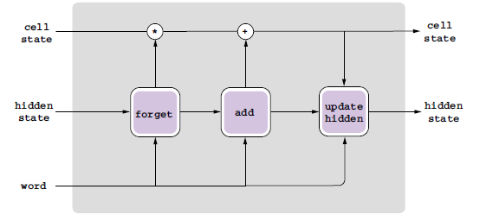
LSTM Cell
A schematic diagram:
Figure 4.8 from Textbook 1

Slide 32
LSTM Cell
Number of units are specified with an LSTM cell: Correspond to the number of nodes in the “forget” and “add” gates; same as the size of the hidden and cell states
Units: 4

Slide 33
LSTM Cell
Stores and propagates the vector of activations (cell state and hidden state)
The propagation of activations through time is controlled by three components called gates:
Forget gate
Removes information from the cell state
Input gate
Adds information to the cell state
Output gate
Updates the hidden state (output of LSTM)
Each gate learns to do its task; has corresponding weights which are learned during training

Slide 34
Forget Gate
An internal neural network trained for “when to forget”
Forget gate compute a 0-1 values using a sigmoid output function from the input, x_{t}, and the current hidden state, h_{t-1}:
Multiplicatively combined (element-wise vector multiplication) with cell state, "forgetting" information where the gate outputs something close to 0 (which then gets multiplied to the cell state)

Slide 35
Input and Output Gates
Input Gate (Add): From hidden state and input word, determines if a value should be added and its value
Uses sigmoid activation (0 to 1) to determine if value should be added
Uses tan hyperbolic activation function (-1 to 1) to determine the value to be added (or subtracted)
Output Gate (Update): Updates the hidden state based on the previous hidden state, cell state and the input word

Slide 36
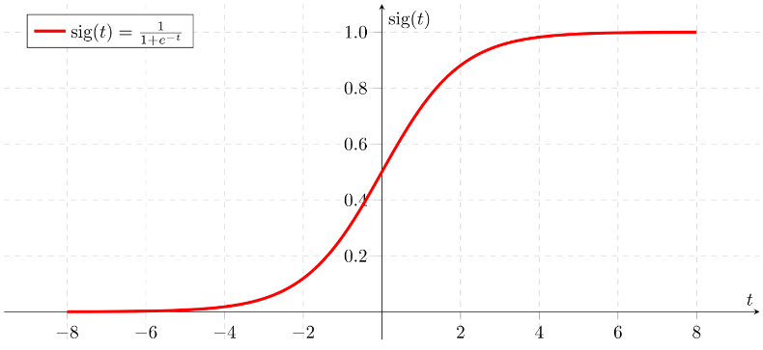
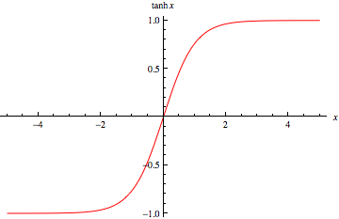
Activation Functions
Sigmoid function (logistic function) is used when output needs to be thresholded between 0 and 1 (e.g. 0 to forget and 1 to remember in the forget gate)
Tanh function is used when the output needs to be thresholded between –1 and 1 (e.g. 1 to add and -1 to subtract)

Slide 37

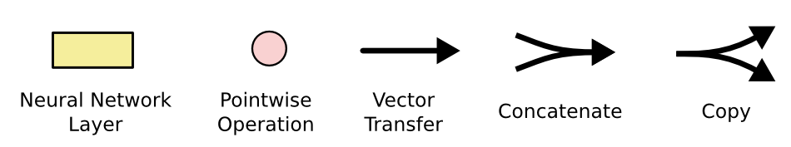
LSTM Cell: Details
An unrolled RNN
Output of hidden
layer at time t
LSTM cell as
hidden layer
Forget
gate
Input
gate
Output
gate
Input at time t
Image source for this and the next two slides:
http://colah.github.io/posts/2015-08-Understanding-LSTMs/

Slide 38

Overall Network Architecture
Inputs from the task will be inputs to LSTM
G
G
G
Output layer
Output layer
Output layer
LSTM Cell (unrolled)
…
…
who
support
the

Slide 39
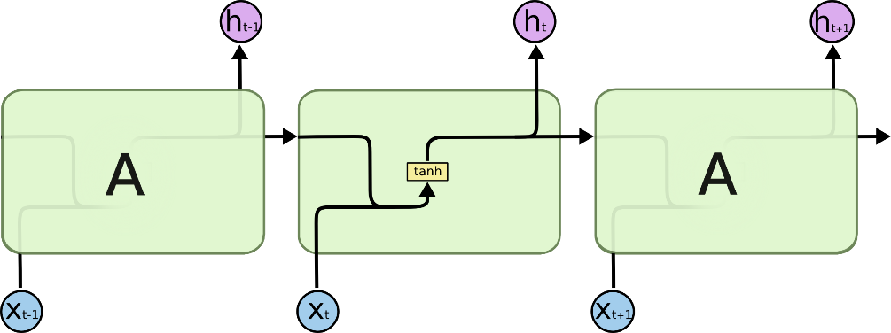
For Comparison: Simple RNN
G
G
G
Output layer
Output layer
Output layer
Unrolled
…
…
who
support
the

Slide 40
Multiple LSTM Layers
One can have multiple LSTM layers too
o_{t}
Output Layer
o_{t}
h’_{t}
Output Layer
LSTM2
h_{t}
h’_{t-1}
LSTM
h_{t-1}
x_{t}
h_{t}
LSTM1
h_{t-1}
x_{t}
Single LSTM Layer
Two LSTM Layers

Slide 41
Gated Recurrent Unit (GRU)
Alternative RNN to LSTM that uses fewer gates
Uses only one state instead of two
First computes the new state from the old state and input word
Then computes a switch value between 0 and 1
The state is chosen between old and new based on the switch value
Switch = 1: switch to the new value
Switch = 0: retain the old value
Switch between 0 and 1: mix the old and new values

Slide 42
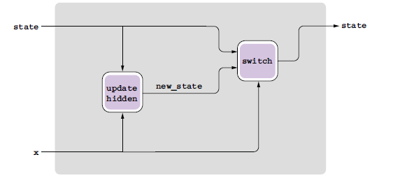
Gated Recurrent Unit (GRU)
GRU Cell:
Figure 4.9 from Textbook 1

Slide 43
Illustrative Example
Cell state:
c(speaker; the,speaker,spoke,against,the,politicians)
c(politicians; the,speaker,spoke,against,the,politicians,who)
New state:
c(politicians; the,speaker,spoke,against,the,politicians,who)
Switch=1
The speaker spoke against the politicians who support the bill.

Slide 44
GRU vs. LSTM
GRU has significantly fewer parameters and trains faster
Experimental results comparing the two are inconclusive, on many problems they perform the same, but each has problems on which it works better
Try both for a task and see which does better on a validation set

Slide 45
Implementations
Most deep learning libraries will have LSTM and GRU recurrent layers implemented

Slide 46
Evaluation Measures (for binary classification)
Sensitivity or true positive rate: Out of all positives how many were correctly predicted positive
Specificity or true negative rate: Out of all negatives how many were correctly predicted negative (same as 1 - false positive rate)
Precision or positive predictive value: Out of all predicted positive how many were correct
Recall: Out of all positives how many were correctly predicted; same as sensitivity
The above are specific to a particular class (positive class in this case).
In binary classification, sensitivity & specificity of the positive class are specificity & sensitivity respectively of the negative class (i.e. they are flip of each other the way they are defined)
Accuracy: Out of all predictions (positives or negatives) how many were correct (same as 1-error rate or 1-misclassification rate)
Is not specific to a particular class but defined for all classes

Slide 47
Evaluation Measures (for binary classification)
 | Predicted Positive | Predicted Negative | Total
Target Positive | 70 (true positives) | 20 (false negatives) | 90
Target Negative | 2 (false positives) | 8 (true negatives) | 10
Total | 72 | 28 | 100
Sensitivity = TP/(TP+FN) = 70/90
Precision = TP/(TP+FP) = 70/72
Specificity = TN/(FP+TN) = 8/10
Recall = TP/(TP+FN) = 70/90
Accuracy = (TP+TN)/(TP+TN+FN+FP) = (70+8)/(70+8+20+2)

Slide 48
Evaluation Measures (for binary classification)
Precision and recall are typically used when the task is to extract some information (e.g. information extraction)
For example, find all protein names from a document
Recall will tell how many protein names it found out of all present in the document
Precision will tell how many protein names it found were correct
Although both are important, precision may be more important for an application and recall may be more important for another application
Why precision and recall for information extraction?
We never need to know the total number of negatives, i.e. how many strings in the document are not protein names, something difficult to compute otherwise (required for specificity)

